Slide 1
Common Problems & Solutions to High Routine Immunization Coverage
An Introduction to the RED strategy

Slide 2
Common Barriers to High RI Coverage
Common reasons for low coverage
Poor access
High dropout / poor utilization
Missed opportunities
Poor management
Community barriers

Slide 3
Poor Access to RI Services
Immunization sessions not conducted due to
Lack of vaccine
Lack of vaccinator
Broken cold chain equipment
Outreach sessions not conducted due to
No funding for fuel, overnite stays
Lack of transport
Lack of cold chain
Immunization sessions too far from community

Slide 4
Poor Utilization of RI Services
All factors listed for poor access can also lead to poor utilization
Additional factors of poor utilization include
Mother not told when to return for vaccination
Mother not told importance of return visit
Mother mistreated by vaccinator

Slide 5
Missed Opportunities to Vaccinate
Vials are not opened every time an infant presents at the facility due to concerns about wastage rate
When infant comes for health services, vaccination status is not checked
Stockout of vaccines, materials

Slide 6
Poor Management of RI
Supervision visits rarely occur
Lack of funding for fuel, transport
Inadequate planning
No microplans created
No tracking of immunization sessions planned versus conducted
Vaccine stockouts
Poor vaccine forecasting, management
Broken cold chain equipment
No funds for cold chain logistics, vaccine

Slide 7
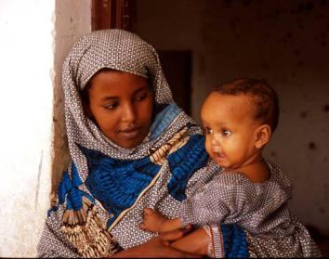
Barriers to High Community Demand
Mothers unaware of importance of vaccination
Inconsistent delivery of RI services creates lack of trust in health system
No community meetings planned by vaccinator or health teams
Key decision-makers not involved in planning or mobilizing for immunization sessions
Village chiefs, husbands
Health committees, local volunteers
Negative vaccinator attitudes towards certain communities
Different tribe, culture, language

Slide 8
ADDRESSING THE BARRIERS

Slide 9
Major strategies for addressing the barriers
“Increasing Immunization Coverage at the Health Facility Level”
Guide for health workers
Use data to identify problems and improve services
Reaching Every District (RED)
Guide for District Health Management Teams
Not new ideas, but more systematic implementation
Global Immunization Vision and Strategy (GIVS)
Immunize more people, from infants to seniors, with a greater range of vaccines
Goal: by 2015 or earlier, reduce illness and death due to vaccine-preventable diseases by at least two thirds compared to 2000 levels
Notes:
On resource CD and in the field manual
Will mix the 2 up in this presentation as it is more likely to occur in the field

Slide 10
The Reaching Every District (RED) strategy is often used to structure strategies to improve RI
Re-establish outreach services
Conduct supportive supervision
Establish community links with service delivery
Monitor and use data for action
Improve planning and management of resources
Much of what we covered in the two previous presentations is included in the RED strategy
Notes:
None of these interventions is new. The idea is that these done better and done together can improve services.
As STOP will probably mostly get involved with planning, esp. of outreach services, improving supervisory techniques and improving monitoring and use of data

Slide 11
Why was RED created?
During 1990s, immunization coverage stagnated
Too much focus on national coverage
Hiding low performance of many districts
Many developing countries decentralizing administrative functions to district level
Identification and improvement of poorly performing districts deemed critical to reduce outbreaks
Assessments indicated that basic operations not happening

Slide 12
Matching RED strategies to barriers
 | Poor access | High dropout/ poor utilization | Missed Oppor- tunities | Manage-ment | Community barriers
Outreach | +++ | ++ | + | + | ++
Supportive supervision | + | + | ++ | ++ | +
Community links | + | + | + |  | +++
Monitoring, use of data | + | +++ | +++ | ++ | +
Resource management | + | + | + | +++ | +
Notes:
Here is an example of how managers might choose to emphasize certain components of the RED strategy to address certain barriers. Some of these are indicators that may reflect problems with one or more barriers at different levels in the EPI program. For example, outreach and data…

Slide 13
RED Strategy: Brief description
Primary objective: Ensure each RED strategy occurs regularly
Outreach
Create a catchment area maps, identify villages for outreach, create an outreach session plan, track sessions planned versus conducted
Supervision
Ensure supervision is a two-way dialogue, solves the vaccinator’s problems. Tracks visits planned versus conducted

Slide 14
RED Strategy: Brief description
Community Links
Maintain regular dialogue with village leaders and identify a social mobilizer focal point
Monitor & Use Data For Action
Accurately monitor key RI information (coverage, dropout) and use them to identify and remedy low performing areas
Planning
Create “living” microplans: Plan fixed and outreach session schedules, forecast vaccine needs, plan community meetings, monitor performance and identify low performing areas

Slide 15
How is RED operationalized?
Countries will
Conduct annual or biannual “RED” trainings
Monitor performance indicators at a district level
Example: Number of districts with 90% coverage
Monitor & report multiple process indicators related to RED implementation
Example: proportion of outreach sessions conducted or planned
Develop national action plans around RED strategies
Global partners provide funding directed at RED activities
Example: Fuel for outreach sessions, supervision visits

Slide 16
Learn more about the RED strategy
African Region RED Guide: http://www.who.int/entity/immunization_delivery/systems_policy/AFRO-RED_Aug2008.pdf

Slide 17
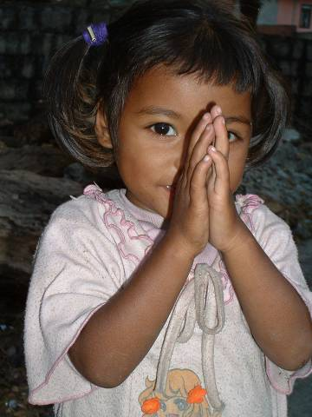
Additional Routine Immunization Resources
Your RI CD
Implementing RED Approach, August 2008
Increasing Immunization Coverage at the Health Facility level

Slide 18
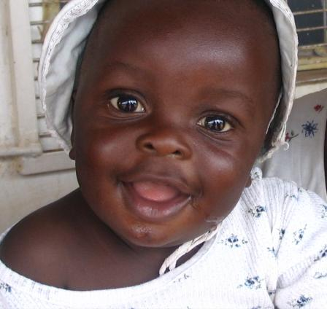
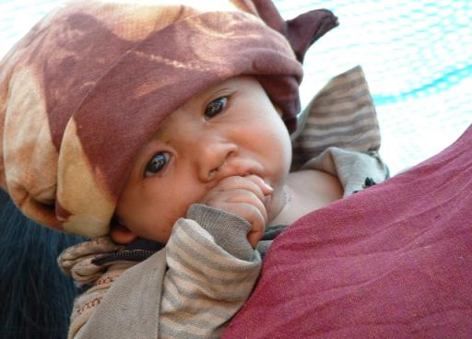
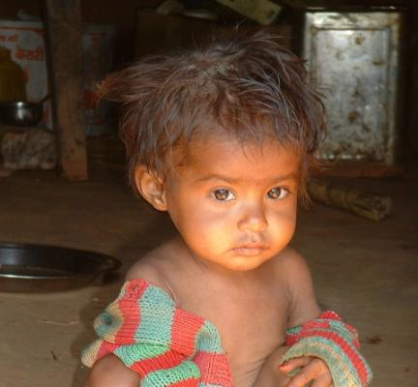
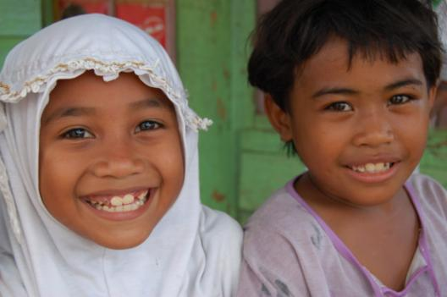

Slide 19
Why RI matters for Polio Eradication
http://www.youtube.com/watch?v=6zW9EB5D3Cw

