Slide 1
Introduction to Vaccine Preventable Diseases
STOP 53 Training
Kampala, Uganda
May 2019

Slide 2
Overview
Part 1
  Vaccine Preventable Diseases (VPDs)
  Global importance
  Surveillance
  Disease burden
  Prevention
  Vaccine impact
Part 2
  VPD Activity – Review of individual VPDs

Slide 3
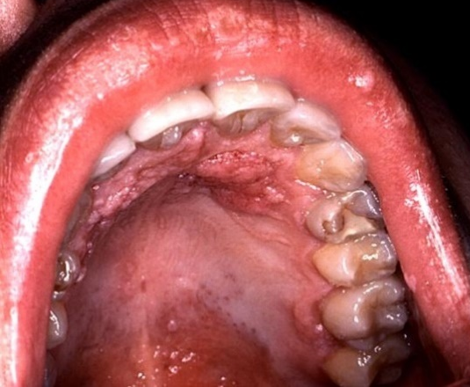
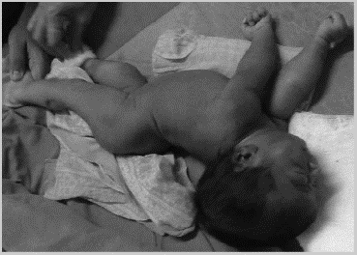
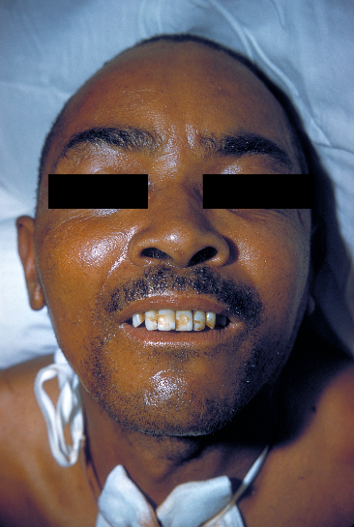
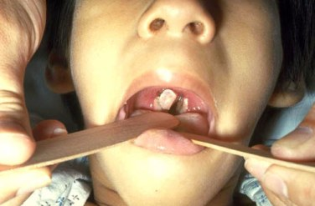
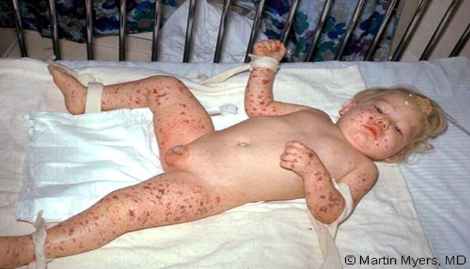
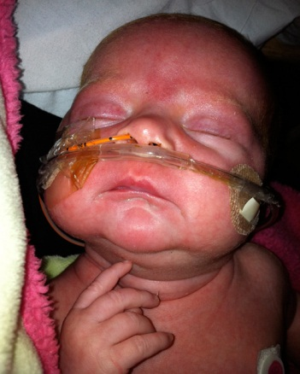
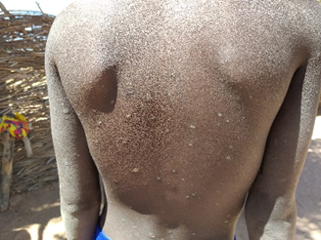
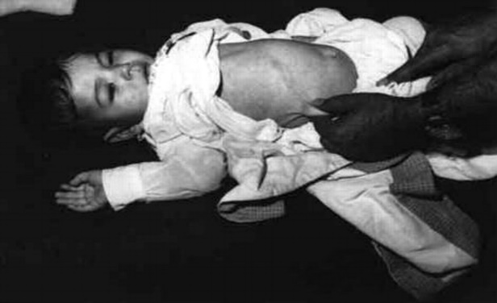
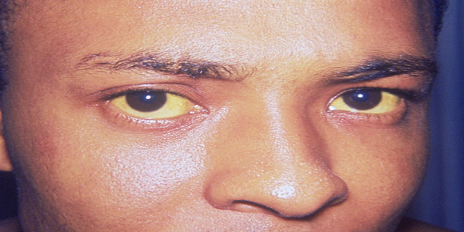
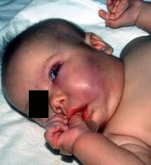
What are Vaccine Preventable Diseases (VPDs)?
Infectious diseases for which vaccines exist that can confer partial or complete protection
  25 licenses vaccines against bacterial and viral infections
Notes:
These photos show just a few of the VPDs that you may have encountered, or will encounter. Some are viral, some are bacterial, and all cause illness, and can lead to death.
The good news is that vaccines are available for over 25 VPDs

Slide 4
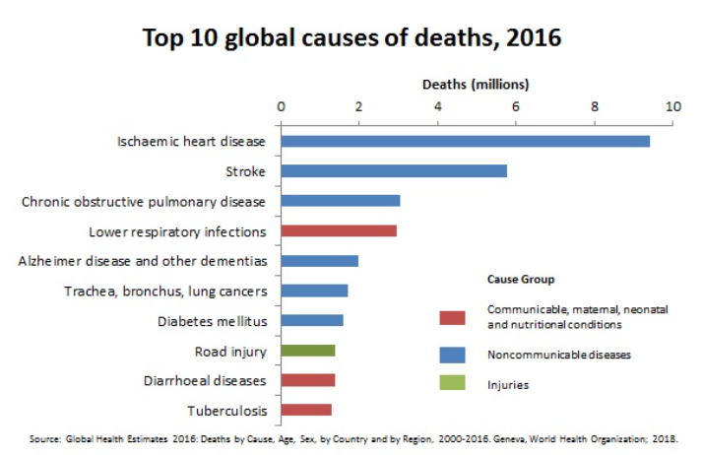
Global Importance of VPDs
Responsible for significant amount of morbidity and mortality
Potential for epidemic spread
Top causes of communicable deaths:
  Respiratory diseases
    Lower respiratory infections – most deadly communicable disease, 3 million deaths in 2016
    Tuberculosis – 1.3 million deaths in 2016
  Diarrheal diseases
    Death rate decreased between 2000-2016, but still claimed 1.4 million lives in 2016
Notes:
I’m sure many of you have had experience with VPDs where you have worked and seen how devastating they can be for families and communities. We are going to spend a few moments now reviewing where VPDs stand in the overall picture of causes of mortality worldwide.

Slide 5
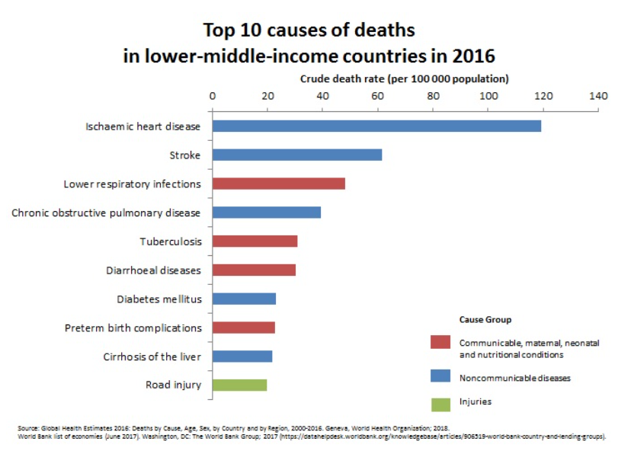
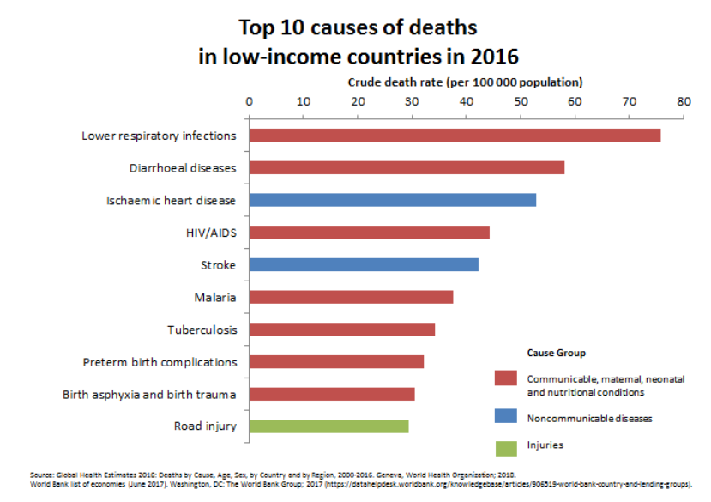
Global Importance of VPDs (cont.)
Notes:
WHO estimates, 2018
When looking at these WHO estimates, note the increase in the communicable diseases noted in the red bars as you move from upper middle income to low income countries
In 2016, Lower respiratory infections, diarrheal disease and TB were the top causes of global deaths overall.
If you look at upper middle income countries, you see Lower respiratory infections
Lower-middle income countries, we see lower repirtaory infections, TB, then diarrheal diseases
In Low income countries we see both lower respiratory infections and diarrheal disease really leading the top 10 causes. Also note the death rates from these are also higher, despite the difference in scale

Slide 6
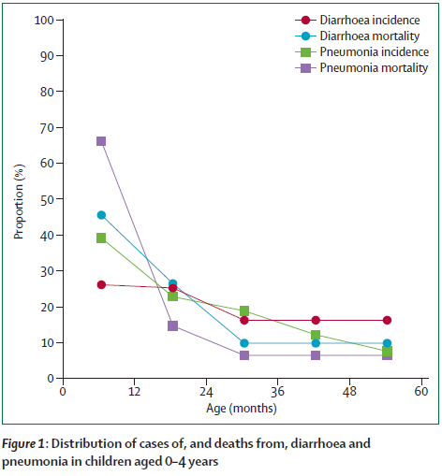
Global Importance of VPDs (cont.)
Selected leadings causes of deaths among children <5 years of age, globally, 2015
Number of deaths in 2015 | Cause
805 800 | neonatal preterm birth complications
740 400 | neonatal birth asphyxia/trauma
703 900 | lower respiratory infections
498 900 | diarrheal diseases
474 100 | malaria
351 700 | Neonatal sepsis + other infections
220 200 | Other neonatal disorders
192 800 | nutritional deficiencies
173 100 | meningitis
88 900 | HIV/AIDS
54 500 | whooping cough
62 600 | measles
25 500* | tetanus
Pneumococcus
Rotavirus
*19, 900 of tetanus cases in neonates
Notes:
So now let’s shift to looking at top causes of death in the <5 age group.
Globally there were 5.8 million deaths in 2015, with communicable, maternal, neonatal and nutritional diseases causing 80% of mortality. The good news is that the majority of these are decreased compared to estimates from 2005, but there is still a lot of work to be done.
This table shows the top categories of deaths contributing to global mortality. The bulk of these deaths are occurring in the 1-59 month age group, except for tetanus, where the bulk of deaths were seen in neonates < 1 month of age (19, 900).
You can see that many of these categories include diseases for which vaccines exist.
Diarrhea caused 8% of deaths in this age group; LRI 12% of deahts in this age group
Causes of diarrheal deaths:
Rota 29%
Cryptosporidiosis 12%
Shigellosis 11%
Adenovirus 10%
Causes of LRI deaths:
Pneumococcal pneumonia 56%
H influenza type b 8%
RSV 5%
Influenza 1%
Perhaps you are thinking, where does this information come from? Which leads us to another key component of VPDs…surveillance
Source: GBD 2015 Mortality and Causes of Death Collaborators, Lancet 2016

Slide 7
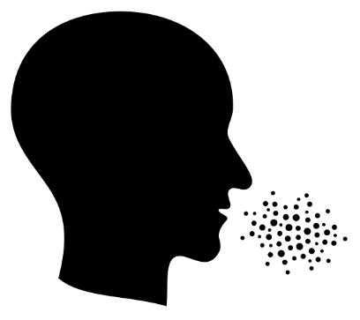
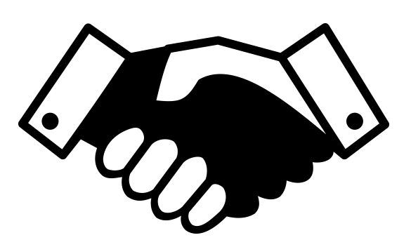
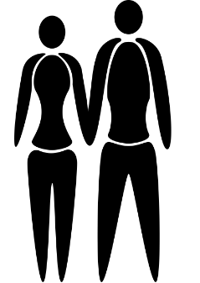

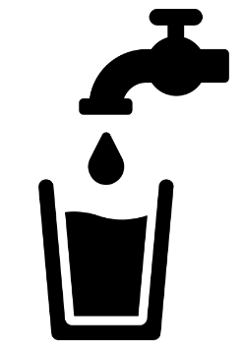
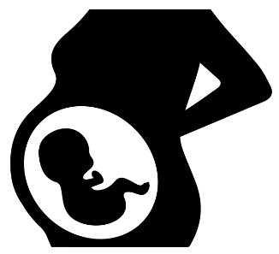
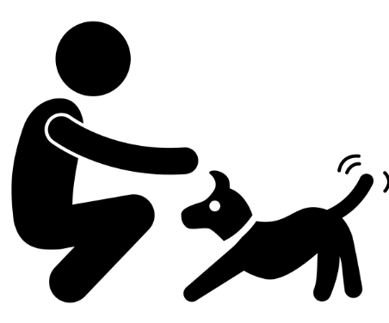
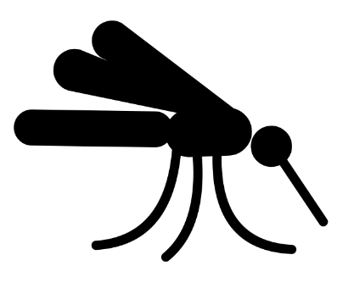

How Are VPDs Transmitted?
Direct
  Person-to-person contact
  Droplet
Indirect
  Airborne
  Contaminated objects
  Food and water
  Animal-to-person contact
  Animal reservoirs
  Vector-borne
  Environmental
Notes:
So how do these infections pass from one person to another? The answer is pathogen specific, that is, each disease has its own specificities, which we will see in our activity at the end of the lecture where we look at specific diseases.
IN GENERAL, VPD transmission can be grouped into direct and indirect modes of transmission. In direct transmission, the virus or bacteria passes directly from an infected person to a susceptible person via personal contact, or droplet contact. With Indirect transmission, a number of other sources of infection spread are implicated. These are listed here.

Slide 8
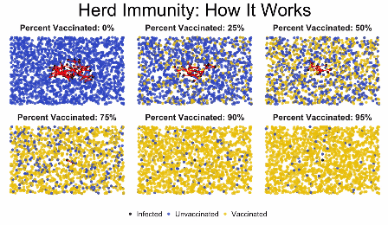
Potential for spread in an unimmunized population
Notes:
http://cdn.iflscience.com/images/610d4613-1b63-5db1-8203-aa881b3f8c09/content-1488280999-animation-7.gif
The specific characteristics of each pathogen as well as the population contribute to this potential for spread, this is a general, simplified example.

Slide 9
What Can We Do to Prevent Transmission of VPDs?
Treatment:
  Antibiotics, antivirals
  Supportive care
Surveillance:
  Timely case investigation and response
Prevention:
  Immunizations
  Vector control
  Micronutrient supplementation
  WASH
Notes:
Well, we can treat them. While treatment can cure some VPDs (but not all), or decrease the severity or complications (but not all), will it do anything to prevent the spread of the disease in the population? In rare cases this can contribute to preventing spread, but in general, prevention is not achievable through this means alone. We will discuss treatment of individual VPDs during part 2.
What about surveillance, with timely case identification, investigation and response? This is also a key component of any VPD program, and we will say a few words about this later
What about prevention through vaccine programs? This graphic now shows different scenarios where that susceptible population we first saw has now been vaccinated, and at different coverage levels, we see the spread of the infection decreases. Apart from vaccination, people who have been infected with a disease, and survived their infection are often protected
This is officially known as herd, or community, immunity- defined as a situation in which a sufficient proportion of a population is immune to an infectious disease (through vaccination and/or prior illness) to make its spread from person to person unlikely. Even individuals not vaccinated (such as newborns and those with chronic illnesses) are offered some protection because the disease has little opportunity to spread within the community.

Slide 10
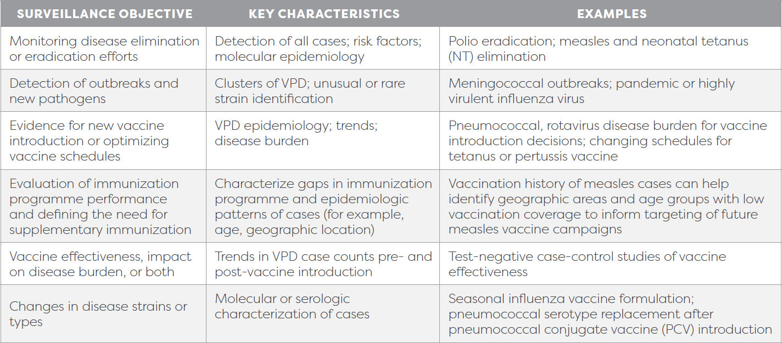
What is VPD Surveillance?
Objectives of VPD surveillance:
Objectives of VPD surveillance can change as the VPD burden is reduced
Notes:
A quick note about this objective, while it is recommended to conduct surveillance for all VPDs, a vaccine with proven potential to reduce morbidity and mortality should be introduced or continued even if the country does not yet do surveillance for a VPD. (SAGE, WHO surv standards 2018)
And finally, objectives can change over time, but VPD surveillance data can always be used to inform immunization programs and/or policies
There are many more details about consideration for surveillance systems, and I urge you to review the newly released WHO surveillance standards for more information

Slide 11
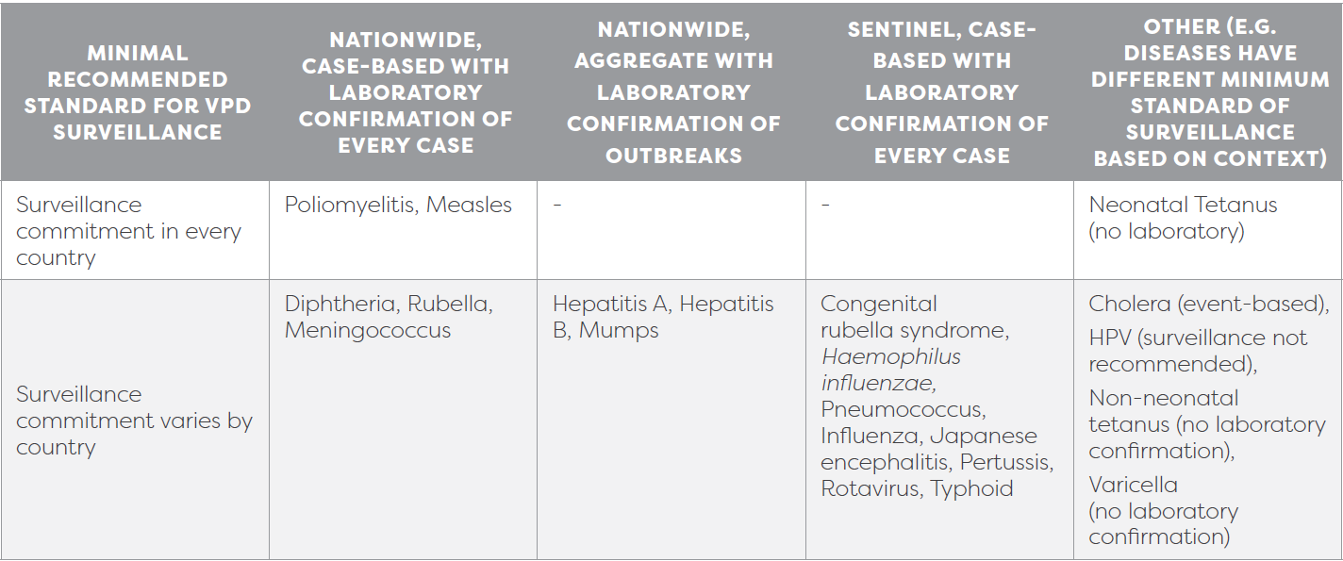
VPD Surveillance (cont.)
Characteristics of VPD surveillance systems:
  National vs subnational
  Population vs sentinel site
  Facility vs community
General categorization of disease specific surveillance standards
  Active vs passive
  Case-based vs aggregate
  Lab confirmed
  Syndromic

Slide 12
VPD Surveillance Data
Need to know what is out there
Need good data to understand the burden of disease and where cases are located
  Sources of data include:
    VPD surveillance platforms
    Administrative data
    Vital statistics
    Health information systems
    Sero-surveys
    Environmental surveillance
    Carriage studies
    Other research studies

Slide 13
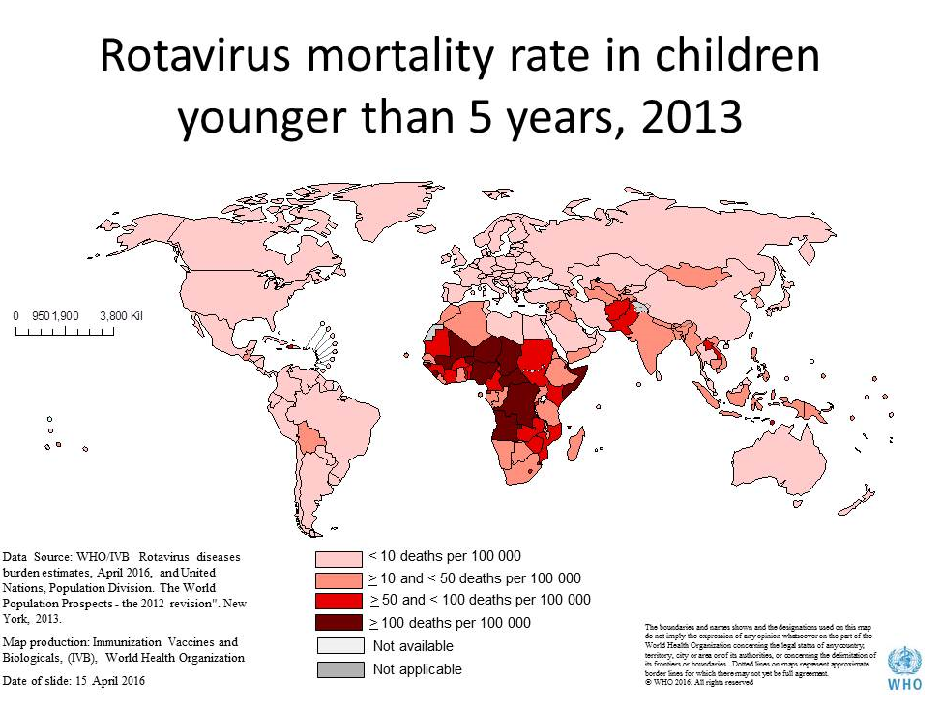
Burden of VPDs
VPD surveillance data are analyzed from a number of sources (listed on the previous slide) to come up with disease burden estimates
Estimated rotavirus mortality in children <5 years
Estimated pneumococcal mortality in children <5 years

Slide 14
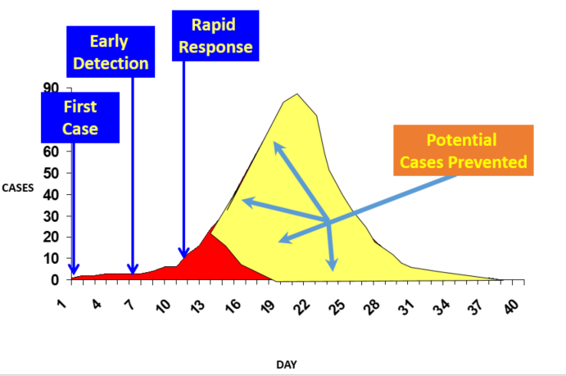
VPD Surveillance – Potential Benefit of Early Detection and Response
Notes:
Graph from GRRT surveillance slides, WHO disease early warning systems http://slideplayer.com/slide/10205598/
we want early detection because it can prompt action. the complete numbers (JRF aggregate reporting) shows annual data, but we want timely review analysis of that reported data to intervene early decrease the overall outbreak

Slide 15
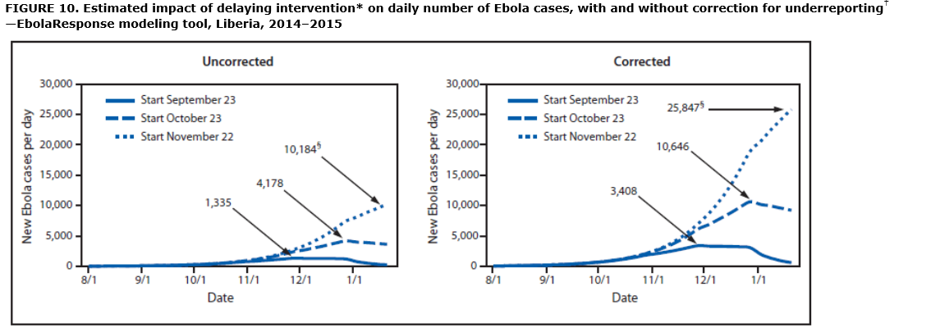
Example: Estimated Impact of Different Response Timing During the Ebola Response in Liberia
Meltzer, 2014 MMWR
Notes:
Intervention: Starting on September 23, 2014 (day 181 in model), and for the next 30 days, the percentage of all patients in Ebola treatment units was increased from 10% to 13%. This percentage was again increased on October 23, 2014 (day 211 in model) to 25%, on November 22, 2014 (day 241 in model) to 40%, and finally on December 22, 2014 (day 271 in model) to 70%. Day 1 in model is March 3, 2014. The impact of a delay of starting the increase in interventions was then estimated by twice repeating the above scenario but setting the start day on either October 23, 2014, or November 22, 2014.
† Corrected for potential underreporting by multiplying reported cases by a factor of 2.5 (Table 4).
§ New Ebola patients at peak of each start date. (Note that when the intervention is started on November 22, 2014, the peak is not reached by January 20, 2014, which is the last date included in the model.)
Alternate Text: The figure above shows the estimated impact of delaying interventions on the daily number of patients with Ebola over time, with and without correction for underreporting in Liberia during 2014, according to the EbolaResponse modeling tool. Starting on September 23, 2014 (day 181 in the model), the percentage of patients hospitalized in Ebola treatment units was assumed to increase from 10% of all patients to 17%. This percentage was increased on October 23, 2014 (day 211 in the model) to 25%, on November 22, 2014 (day 241 in the model) to 40% and on December 22, 2014 (day 271 in the model) to 70%.

Slide 16
Prevention of VPDs – The EPI Program
Routine Immunizations (RI)
- Primary series
- Booster doses
Supplemental Immunization
Activities (SIAs)
Notes:
First a word about routine immunizations. Countries have national immunization programs, these includes routine and supplementary immunization activities.
Here is the overall framework for national immunization programs, as you can see, it includes many components, including surveillance, which we have discussed, and immunization delivery, which is what we will now discuss.
Routine immunizations and Supplementary immunization activities are part of EPI and fall under Service delivery.

Slide 17
Available Vaccines to Prevent VPDs
Vaccines Available for General Use in RI Programs | Vaccines for Special Populations/Non-Routine Uses
BCG (Tuberculosis) | Meningococcal
Polio (IPV, OPV) | Hepatitis A
Diphtheria, Tetanus and Pertussis (DTP) | Japanese Encephalitis
Measles | Yellow Fever
Hepatitis B | Mumps
Haemophilus influenzae type B | Influenza
Rubella | Varicella
Rotavirus | Rabies
Pneumococcal | Dengue
Human Papillomavirus (HPV) | Cholera
 | Smallpox
 | Typhoid conjugate
Notes:
So we mentioned earlier that VPDs are diseases have vaccines available for partial or complete protection, here is a list.
This list is not exhaustive- there are other vaccines (adenovirus, hepatitis E) either in limited use.
Also, there are more vaccines actively in development, (noro, rsv, ebola, shigella, cryptosporidium, ETEC…) More vaccines are in the pipeline!
We’ll also have an opportunity in the next lecture to look specifically at RI schedules

Slide 18
Overview of Global Strategies for VPDs
Control: The reduction of disease incidence, prevalence, morbidity or mortality to a locally acceptable level as a result of deliberate efforts; continued intervention measures are required to maintain the reduction
  Example: diarrheal diseases
Elimination of disease: Reduction to zero of the incidence of a specified disease in a defined geographical area as a result of deliberate efforts; continued intervention measures are required
  Example: neonatal tetanus
Elimination of infections: Reduction to zero of the incidence of infection caused by a specific agent in a defined geographical area as a result of deliberate efforts; continued measures to prevent re-establishment of transmission are required
  Example: measles, poliomyelitis
Eradication: Permanent reduction to zero of the worldwide incidence of infection caused by a specific agent as a result of deliberate efforts; intervention measures are no longer needed
  Example: smallpox
Extinction: The specific infectious agent no longer exists in nature or in the laboratory
  Example: none
Notes:
Source of definitions – Dowdle, Walter R., The Principles of Disease Elimination and Eradication, CDC MMWR, https://www.cdc.gov/mmwr/preview/mmwrhtml/su48a7.htm

Slide 19
Success Story in Global VPD Control
Smallpox – first global action against VPDs
  Global Smallpox Eradication Program led by WHO began in 1966
  Last natural case in 1977
  Declared eradicated in 1980
  One of public health’s greatest historical gains
Notes:
Photo credit: http://www.who.int/vaccine_safety/initiative/tech_support/Vaccine-safety-E-course-manual.pdf

Slide 20
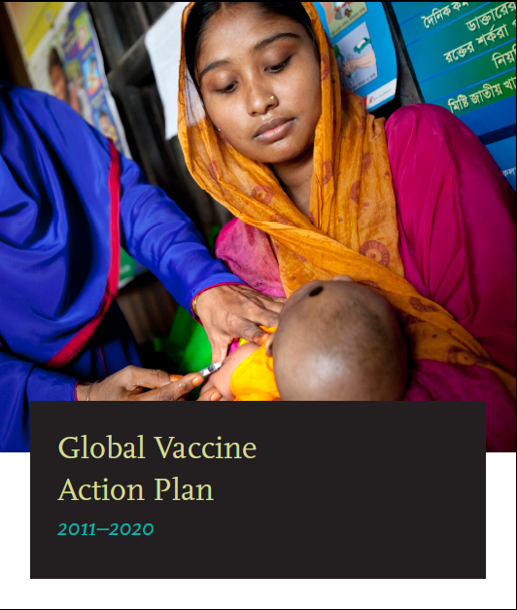
Global Strategies for Prevention of VPDs
Global Vaccine Action Plan (GVAP)
  Goals for 2011-2020
Achieve a world free of poliomyelitis
Meet global and regional elimination targets
Meet vaccination coverage targets in every region, country and community
Develop and introduce new and improved vaccines and technologies
Exceed the MDG4 target for reducing child mortality
Notes:
Global strategies for VPD prevention are outlined in the The global vaccine action plan (GVAP). GVAP includes key objectives for disease elimination, and vaccine introductions.

Slide 21
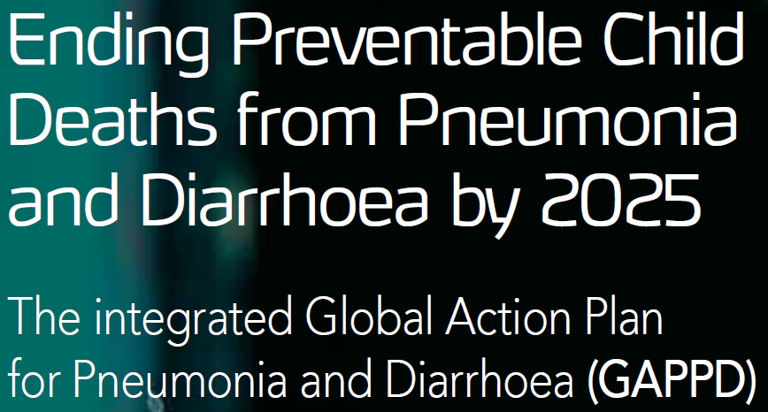



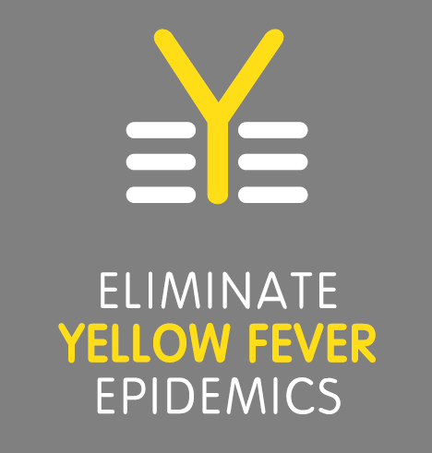

Global Strategies for Prevention of VPDs (cont.)
Global Action Plan for Prevention and Control of Pneumonia and Diarrhea
Measles and Rubella Initiative
Polio Eradication Initiative
Global Health Sector Strategy on Viral Hepatitis
Maternal and Neonatal Tetanus Elimination Initiative
End TB Strategy
Eliminating Yellow Fever Epidemics
Defeating Meningitis by 2030 Initiative
Ending Cholera
…and more
Notes:
You’ll hear more about some of these global strategies in later lectures. We will be focusing on vaccines, but it is important to remember that these strategies include non-vaccine initiatives as well.

Slide 22
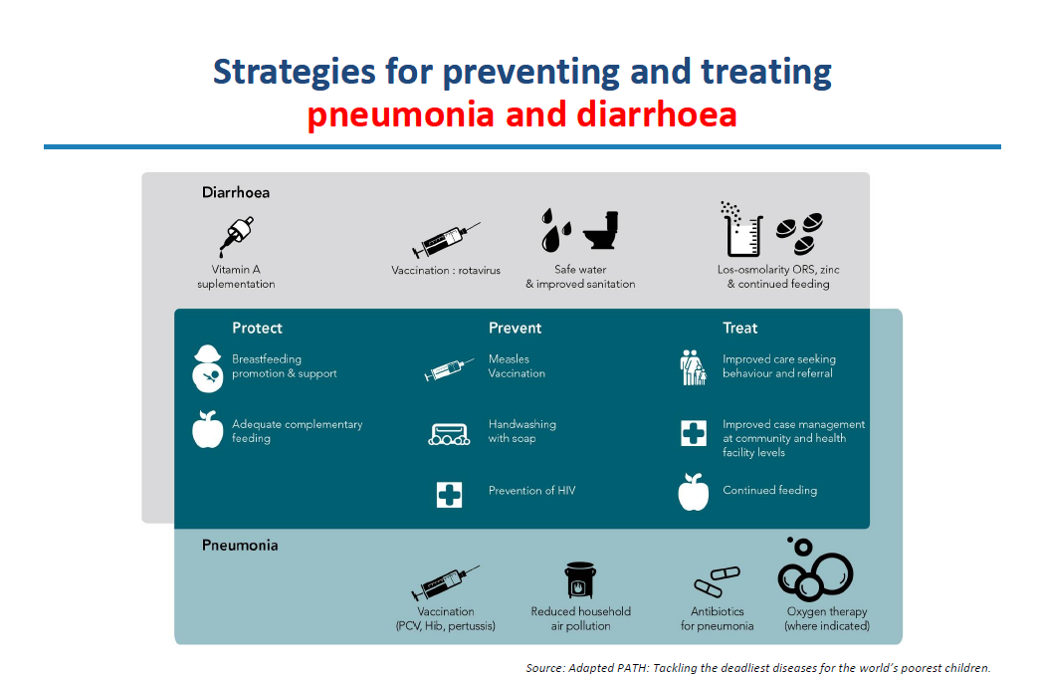
Example: Global Action Plan for Prevention and Control of Pneumonia and Diarrhea
Notes:
Since I have highlighted respiratory and diarrheal diseases as top 10 causes of mortality, I want to also mention the global strategy geared towards these diseases –
The global action plan for prevention and control of pneumonia and diarrhea.
In addition to immunization, this plan details other key strategies to prevent these diseases. As you can see, these include nutritional, environmental, sanitation and hygiene and curative strategies in addition to immunization.
But let’s turn the rest of our focus to immunizations. What has EPI and this global strategy accomplished?

Slide 23
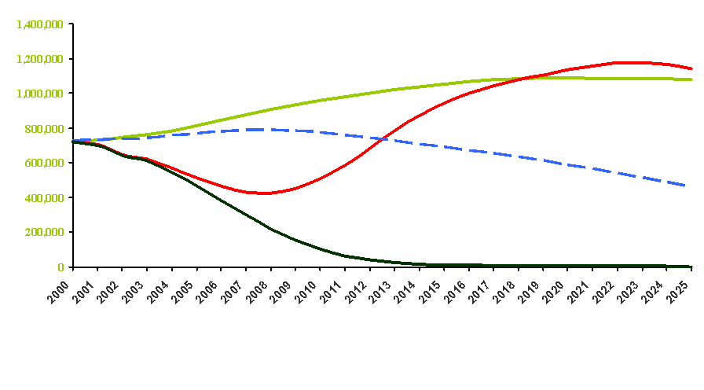
Prevention of VPDs – How RI Programs Can Support VPD Control
Together routine immunization (RI) and supplementary immunization activities (SIAs) can most quickly decrease deaths
Strong EPI systems support the control, elimination and eradication of VPDs
Annual measles deaths
“Catch-up” + constant routine
Constant routine
Strengthen routine only
Strengthen routine + “catch-up” + SIAs
Note: routine strengthening assumes 2.5% annual improvement in routine immunization coverage until 95%
Year
Notes:
Strengthening of routine, with good catch up practices, and well planned SIAs, work best to decrease VPD deaths.

Slide 24
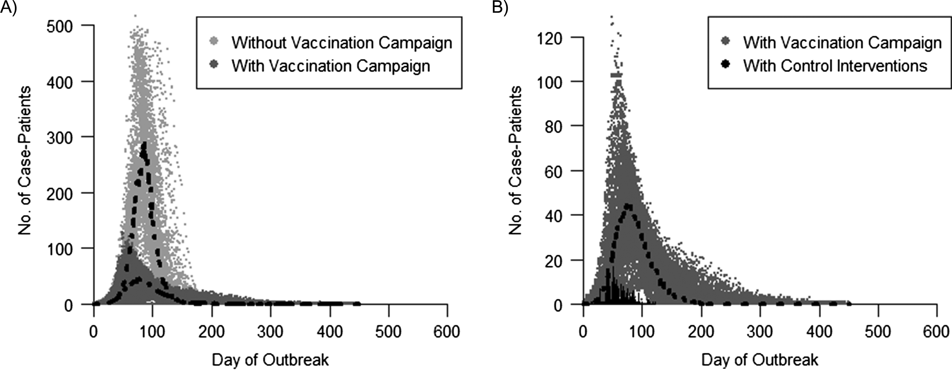
Example: Estimated Impact of Different Interventions During Measles Outbreak
Projected and observed daily incidence of measles cases during a measles outbreak in an Amish community, US
Without campaign
With campaign
With campaign
Campaign + other interventions
Notes:
American Journal of Epidemiology, Volume 187, Issue 9, September 2018, Pages 2002–2010, https://doi.org/10.1093/aje/kwy082
The content of this slide may be subject to copyright: please see the slide notes for details.

Slide 25
Prevention of VPDs – Global Coverage Estimates (1980-2017)
BCG, DTP 1st and 3rd, Measles 1st and 2nd, Rubella 1st, HepB birth and 3rd, Hib3, Pol3, YFV, PCV3 and Rota (last dose)
Source: WHO/UNICEF coverage estimates 2017 revision, July 2018.
Immunization Vaccines and Biologicals, (IVB), World Health Organization.
194 WHO Member States. Date of Slide: 15 July 2018.
Notes:
Here is the current (2017) status of vaccine coverage globally?
Vaccine coverage is, on the whole, increasing over time for EPI antigens.
But has there been any impact, as we saw in the Paho measles data?
Vaccine coverage is, on the whole, increasing over time for EPI antigens.
…However, we aren’t at target and many children remain unimmunized, and many girls aren’t benefiting from HPV vaccine protection

Slide 26
Prevention of VPDs – Vaccine Impact
Immunizations can reduce burden of certain infectious diseases
25% of deaths in children <5 years of age are prevented through vaccination with existing vaccines (including pneumonia and diarrhea)
Global Under 5 year Mortality and Percentage of VPD Deaths
Notes:
Source: Rota: Preliminary data (Us Centers for Disease Control), Hib and PCV: John’s Hopkins University, other causes: WHO – Global Health Observatory
Here are some overall trends
Note that impact on VPDs is likely due to other factors in addition to vaccines, and some of the following disease specific slides overlay disease trends with vaccine coverage, but we say “vaccine impact” for short in this presentation,

Slide 27
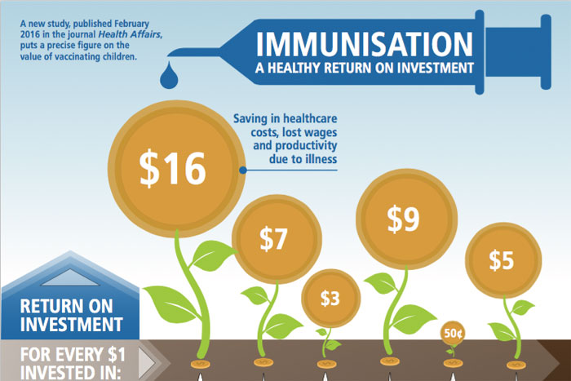
Economic Impact of Vaccine Programs
Vaccines have a high return on investment
  For every $1 invested, immunizations pays back
    $16 from costs associated with illness and lost productivity
    $44 from costs associated with broader economic impact of illness
Immunization
Public
infrastructure
Government
bonds
Pre-school
education
Community
Health Workers
Cardiovascular
research
Notes:
So all of these diseases we have discussed cause morbidity and mortality, but also economic costs. Vaccines can prevent these burdens.
Source: Ozawa S, Clark S, Portnoy A, et al. Health Aff (Millwood). 2016 Feb;35(2):199-207
New vaccines against pneumonia (Hib, PCV) and diarrhea (rotavirus) are significant contributions to this investment

Slide 28
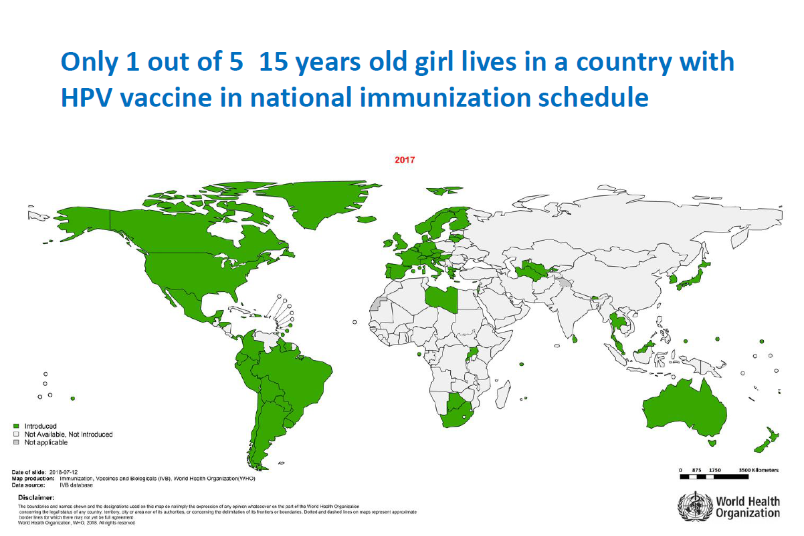
Conclusion
Top 10 countries with most under- and un-vaccinated children (DTP3), in 2017
We still have a lot of work to do!
Source: WHO/UNICEF coverage estimates 2017 revision, July 2018.
Immunization Vaccines and Biologicals, (IVB), World Health Organization.
194 WHO Member States. Date of slide: 18 July 2018.
Notes:
10 countries are responsible for the majority of these un/underimmunized children

Slide 29
VPD Activity
Instructions:
  Review worksheet that is being distributed
  Walk around the room and read the specific VPD posters
  Use the information on the posters to complete your worksheet (45 min)
  We will discuss together as a group at the completion of the activity

Slide 30
Summary
Vaccine preventable diseases contribute to significant burden, particularly in low and lower-middle income settings
Use of vaccines has decreased the burden of VPDs
Commitment to surveillance and immunization programs can continue to decrease the burden of VPDs and meet GVAP goals

Slide 31
Additional VPD Resources
CDC Epidemiology & Surveillance of VPDs (Pink Book) http://www.cdc.gov/vaccines/pubs/pinkbook/index.html
Webinar Series for Pink Book http://www.cdc.gov/vaccines/ed/webinar-epv/index.html
Immunization Essentials: A Practical Field Guide – http://www.immunizationbasics.jsi.com/Resources_General.htm
Summary tables of WHO recommendations for vaccines - http://www.who.int/immunization/policy/immunization_tables/en/
WHO Surveillance Standards (2018) –
https://www.who.int/immunization/monitoring_surveillance/burden/vpd/standards/en/
WHO Vaccine Position Papers
https://www.who.int/immunization/documents/positionpapers/en/

Slide 32
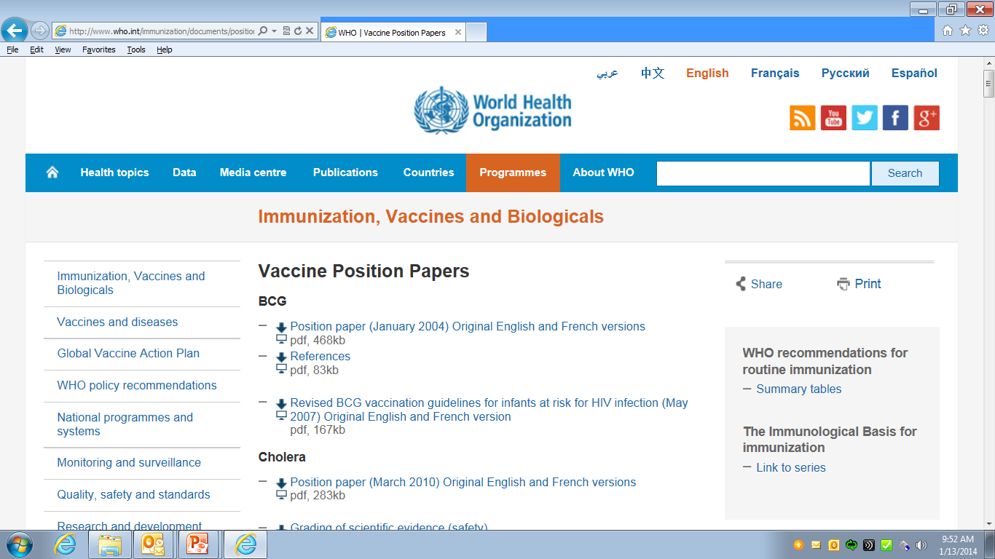
Your Best Resource
http://www.who.int/immunization/documents/positionpapers/en/
Notes:
WHO releases position papers about vaccination for each antigen. More about these will be covered in the introduction to RI presentation.

Slide 33
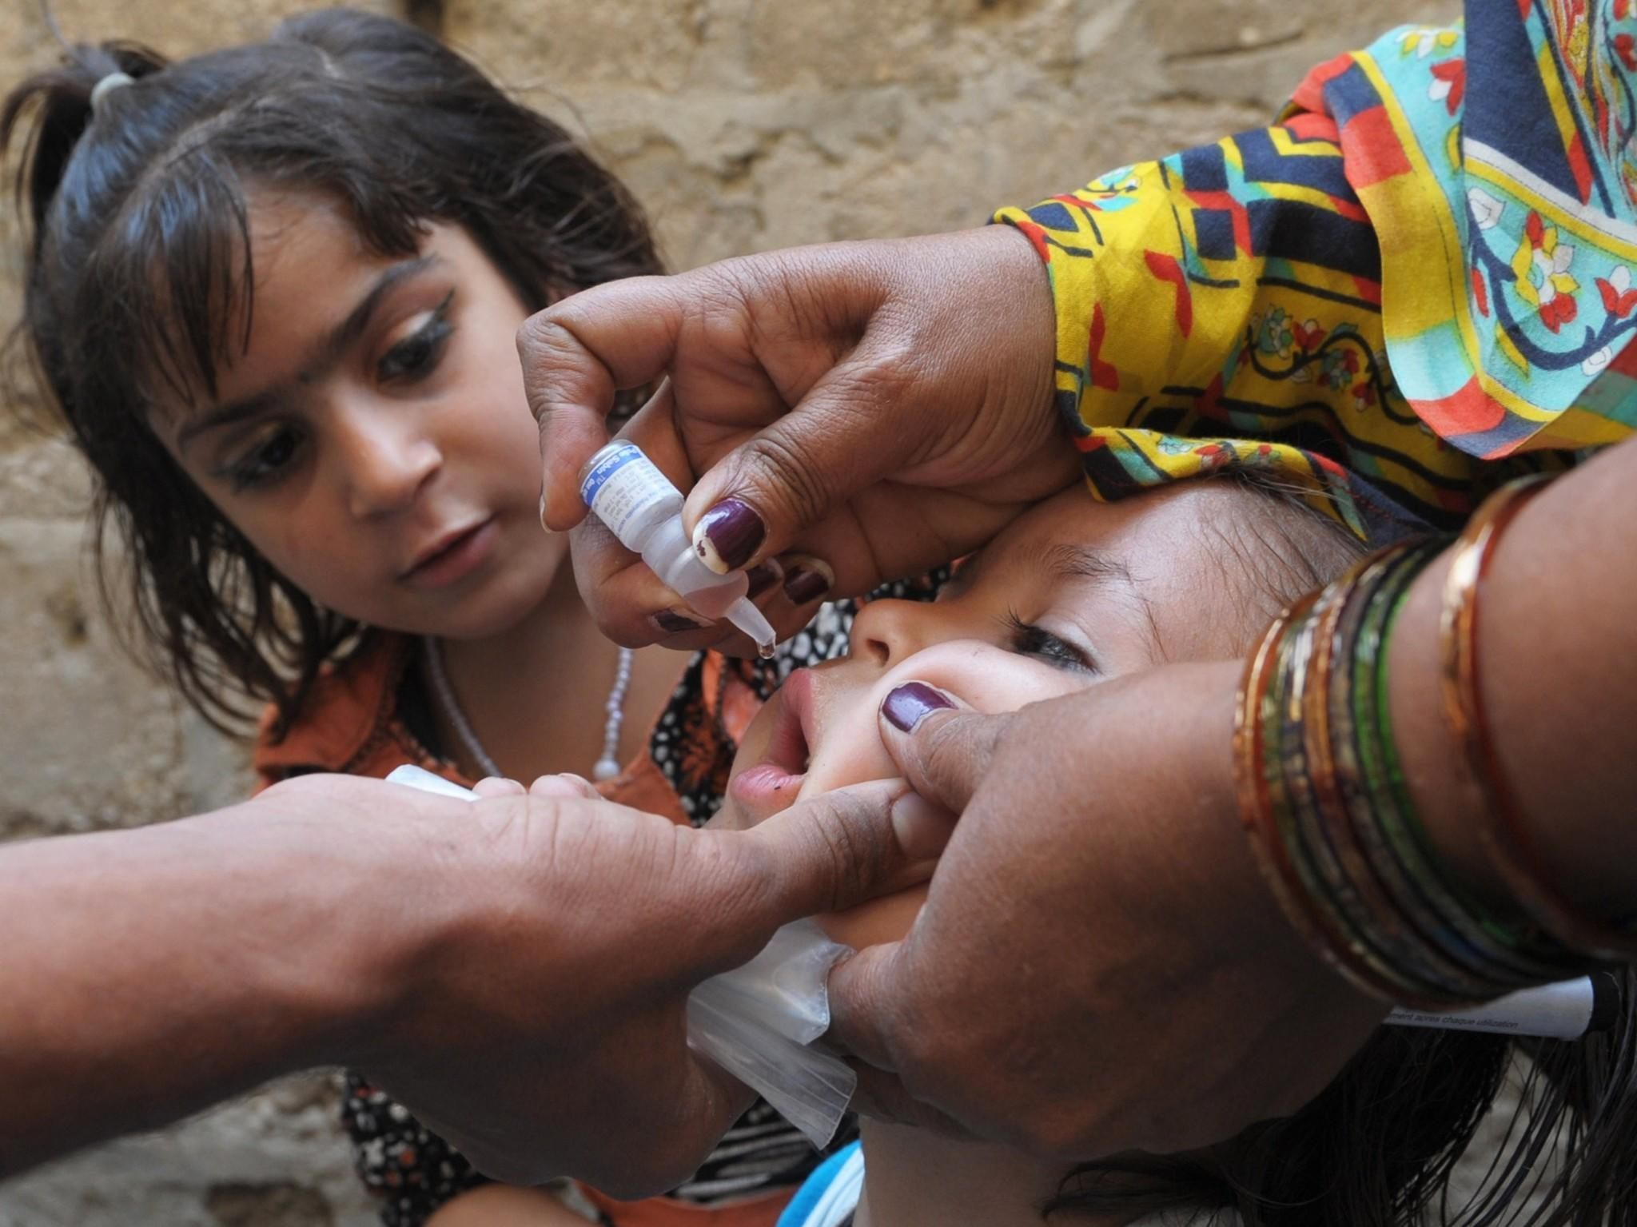
Thank You!

Slide 34
Extra slides

Slide 35
Extra global burden slides

Slide 36
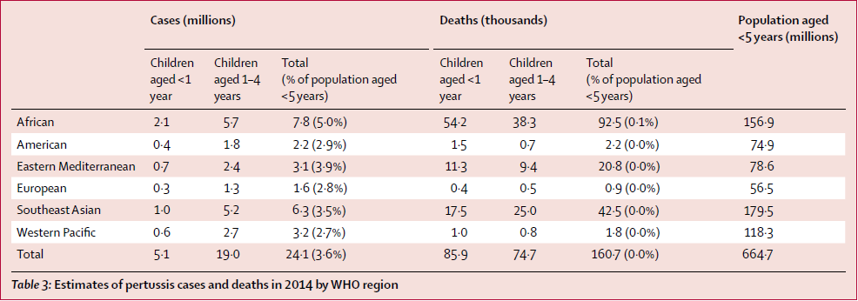
Estimates of pertussis cases and mortality, children aged under 5 years, 2014

Slide 37
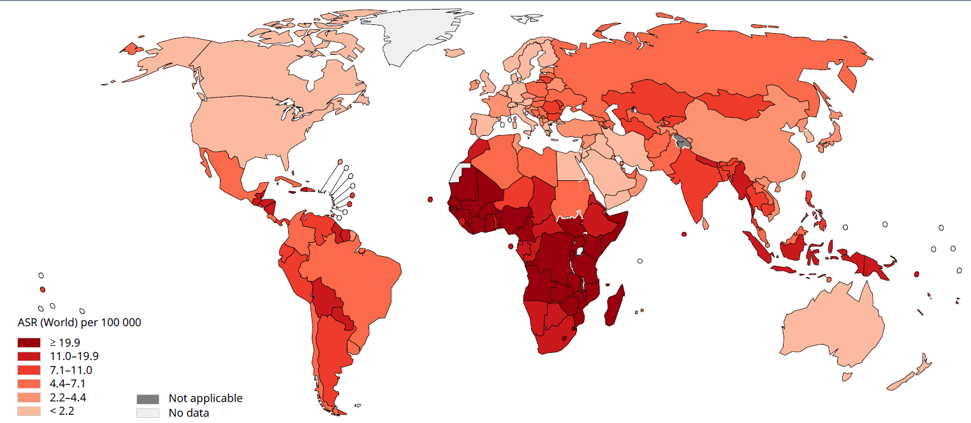
Estimated age-standardized mortality rate of cervical cancer, 2018
Notes:
In addition to the diseases I showed you, these are global data for mortality rate of cervical cancer- which is associated with HPV infection.
Source: GLOBOCAN 2018 (IARC)
So we have demonstrated significant burden, particularly in lower resource settings. What can we do to prevent them?

Slide 38
Impact of selected vaccines

Slide 39
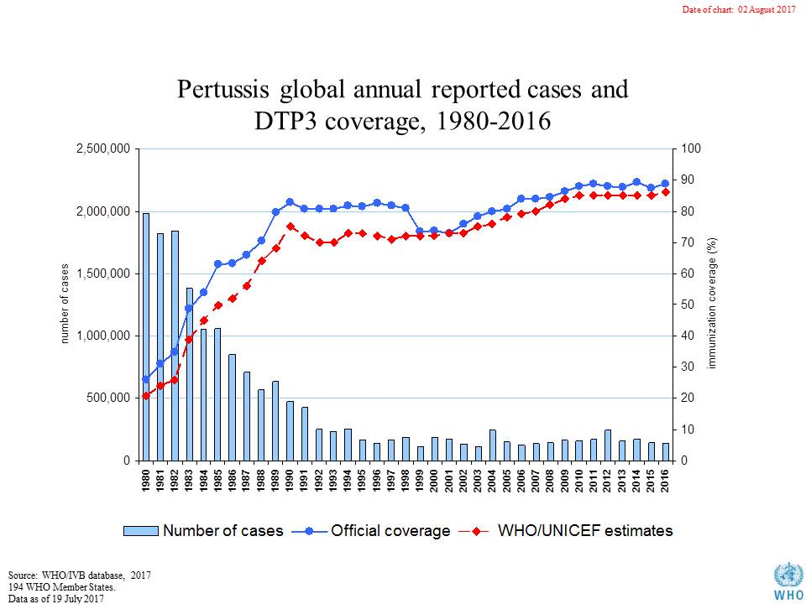
Notes:
Trends in pertussis cases and DTP3 coverage

Slide 40
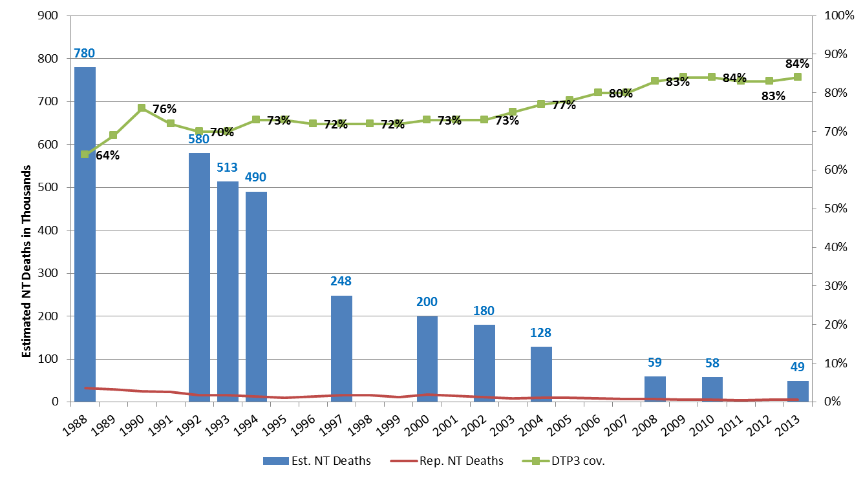
Trend in Global Estimated and Reported Neonatal Tetanus Deaths 1988-2013
≈94% reduction in last 25 years!!!
Source: WHO/UNICEF database & CHERG Reports March 2015

Slide 41
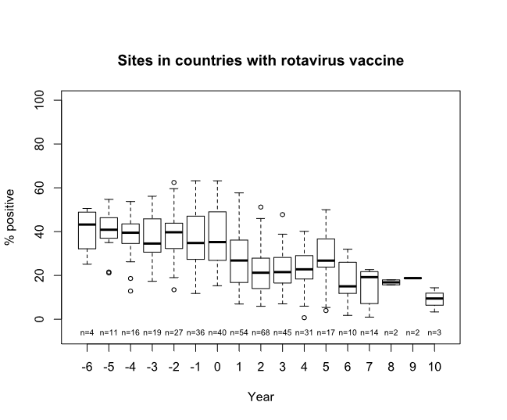
Global rotavirus vaccine impact on severe diarrhea, 2008-2016
Aliabadi, Lancet GH, In press. Courtesy of WHO.
Notes:
Here, we see the median proportion of confirmed rotavirus diarrhea hospitalizations globally. The zero year indicates the year of vaccine introduction. The blue box is the pre vaccine period. You can see over time that severe hospitalizations due to rotavirus infection have decreased.
Of note, for rotavirus disease, hygiene measures do not reduce vaccine impact.

Slide 42
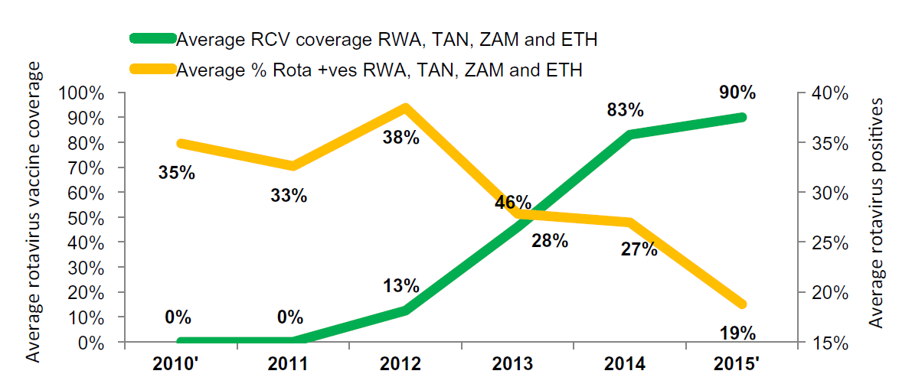
Rotavirus impact on severe diarrhea
Weldegebriel, 2017 Vaccine
Notes:
Decrease in Rotavirus-positive Cases with Increasing Rotavirus Vaccine Coverage in Four African Countries, 2010–2015. Sentinel site surveillance
This surveillance study from 4 countries in Africa shows decline in rotavirus-positive diarrhea hospitalizations among children under 5 years old (in yellow) with increasing vaccine coverage in green
Source: Weldegebriel G, Mwenda JM, Chakauya J, et al. Vaccine. 2017 Oct 25. pii: S0264-410X(17)31458-5

Slide 43
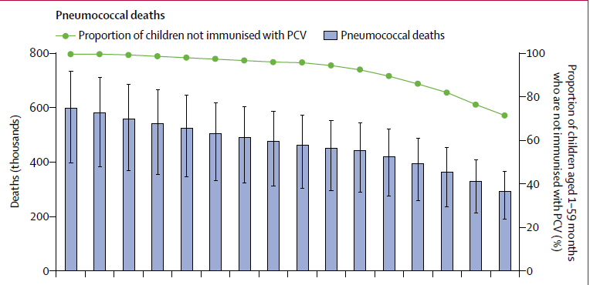
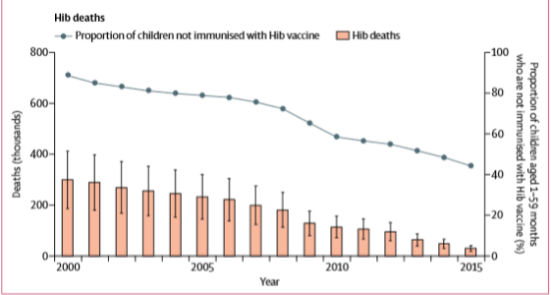
Pneumococcal and Hib vaccine impact
Wahl 2018 Lancet
Notes:
Deaths due to Pneumococcus and Hib in 1-59 month olds and proportion unimmunized, 2000-2015. Modeling estimates.
Source: Wahl Lancet 2018.

Slide 44
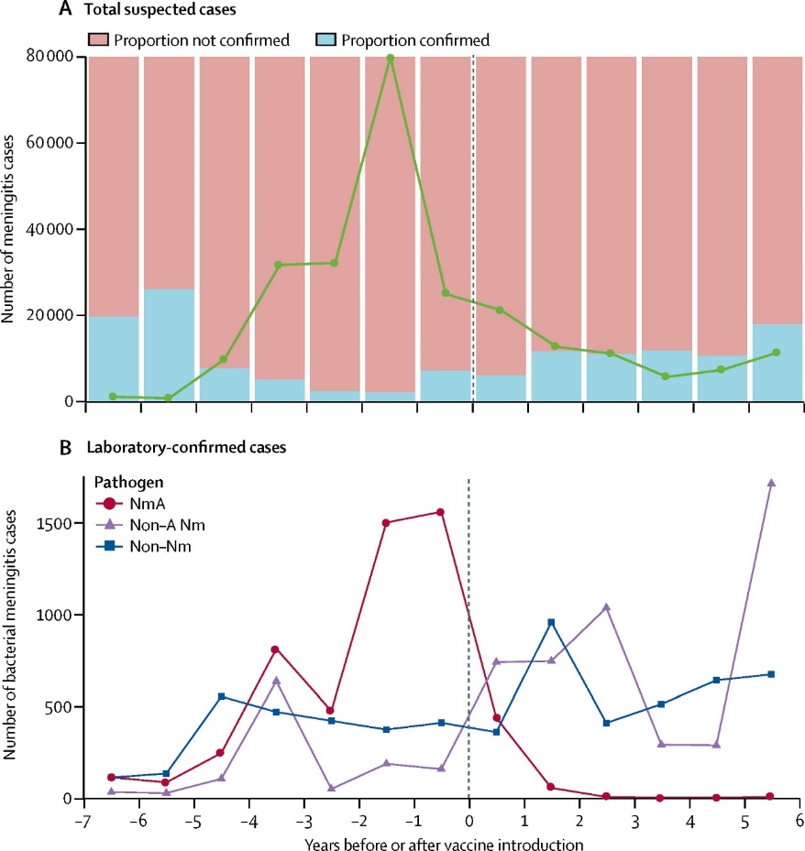
MenAfriVac impact
Trotter 2017 Lancet ID
Notes:
Total annual suspected and confirmed cases of bacterial meningitis across 9 countries of the African meningitis belt, in reference to MenAfriVac introduction (dotted line)
Source: Trotter Lancet ID 2017.

Slide 45
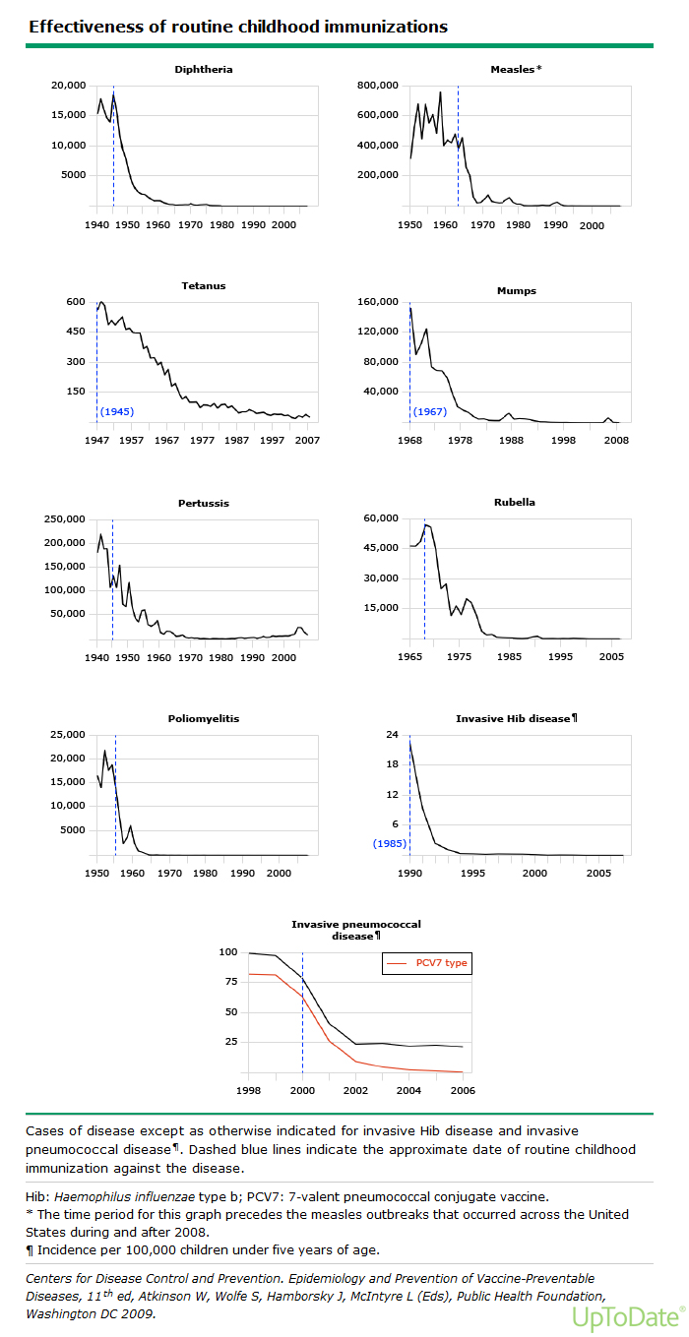
Impact of routine immunizations in the US
Notes:
In the united states, the number of cases of most VPDs declined by more than 90% after routine childhood immunizations were introduced.
Cases of disease except as otherwise indicated for invasive Hib disease and invasive pneumococcal disease¶. Dashed blue lines indicate the approximate date of routine childhood immunization against the disease.
Hib: Haemophilus influenzae type b; PCV7: 7-valent pneumococcal conjugate vaccine.
* The time period for this graph precedes the measles outbreaks that occurred across the United States during and after 2008.
¶ Incidence per 100,000 children under five years of age.
Centers for Disease Control and Prevention. Epidemiology and Prevention of Vaccine-Preventable Diseases, 11th ed, Atkinson W, Wolfe S, Hamborsky J, McIntyre L (Eds), Public Health Foundation, Washington DC 2009.

Slide 46
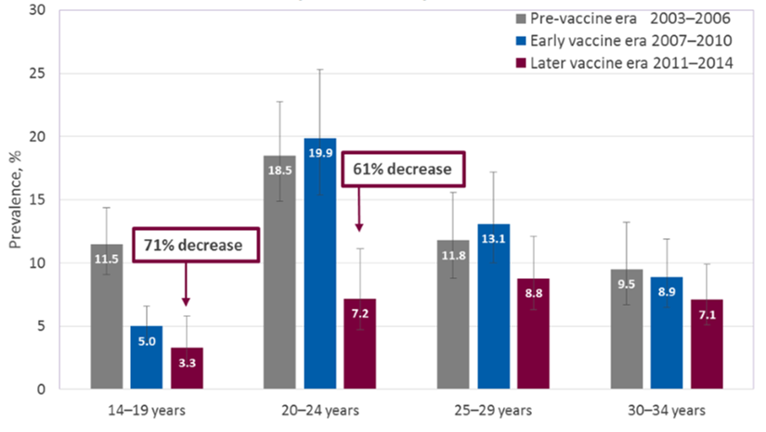
Substantial Decline in Prevalence of HPV Types 6, 11, 16, 18, Following HPV Vaccine Introduction
Prevalence of Human Papillomavirus (HPV) Types 6, 11, 16, 18 by Age Group; NHANES United States, 2003–2014
14–19 years old 20–24 years old 25–29 years old 30–34 years old
Markowitz LE, Hariri S, Lin C; et al. J Infect Dis. 2013 Aug 1;208(3):385-93 Oliver SE, Unger ER, Lewis R et al. J Infect Dis. 2017 Sep 1;216(5):594-603
Notes:
Data from the United States show substantial decline in prevalence of HPV types 6, 11, 16 and 18 within the first 4 years after HPV vaccine introduction and further decreases in the following 4 years.

Slide 47
Country specific vaccine impact estimates

Slide 48
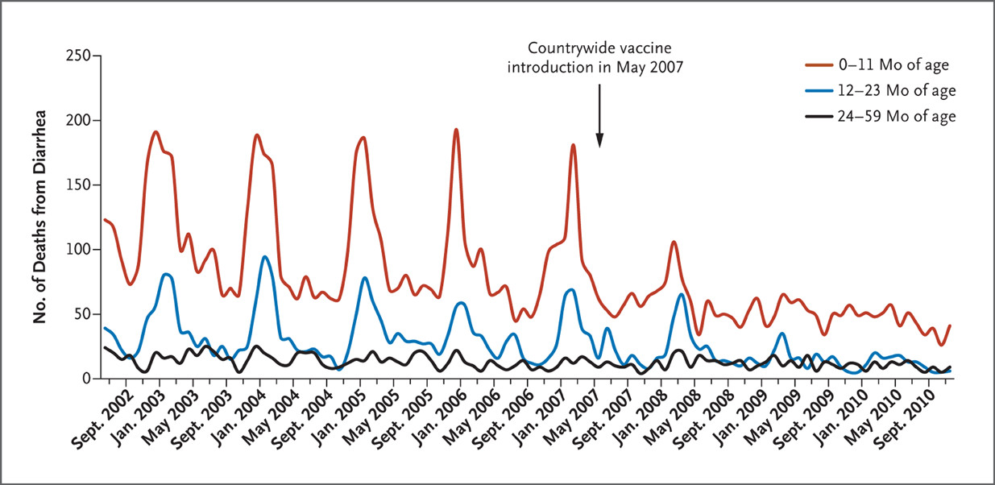
Rotavirus impact on diarrhea mortality
Number of Diarrhea-related Deaths among Children <5 years age, Mexico, 2002–2010
Number of deaths from diarrhea
Richardson V, Parashar U, Patel M. N Engl J Med. 2011 Aug 25;365(8):772-3
Notes:
Dramatic Reduction in Diarrheal Deaths Following Rotavirus Vaccine Introduction in Mexico
This figure from disease surveillance in Mexico highlights impressive reduction in all-cause diarrheal death following rotavirus vaccine introduction.
Administrative data

Slide 49
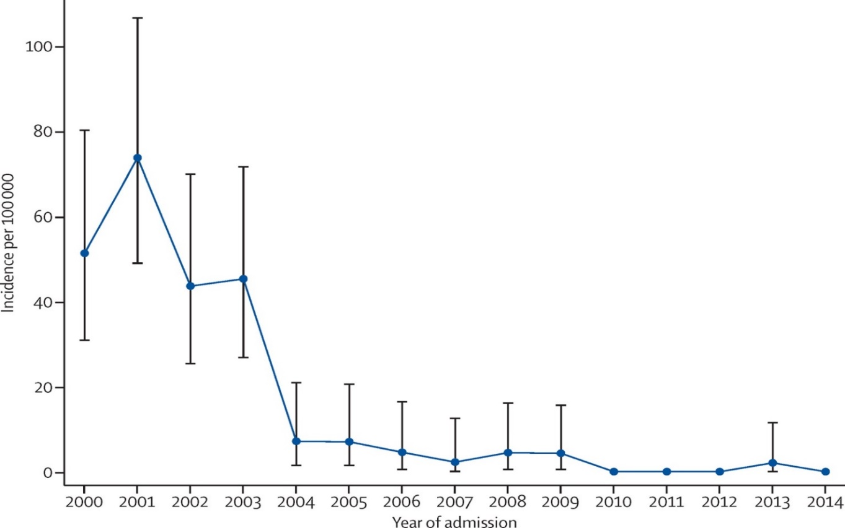
Incidence of Invasive Hib Disease Declines Following Hib Vaccine Introduction in Children Younger than 5 Years
Incidence of Invasive Hib Disease in Children <5 years, Kilifi, Kenya, 2000–2014
Hib Vaccine Introduction
Cases of Hib disease per 100,000
Year of Admission
Notes:
This figure shows impressive decline in invasive Hib disease in children under 5 in a region in Kenya, which has had ongoing disease surveillance since the late 1990s.
Hib: Haemophilus influenzae type b
Source: Hammitt LL, Crane RJ, Karani A, et al. Lancet Glob Health. 2016 Mar;4(3):e185-94

Slide 50


Reduction in Annual Pneumonia Incidence Following PCV Introduction in The Gambia
Incidence of Radiological Pneumonia with Pneumococcal Pneumonia and Hypoxic Pneumonia in the Basse Health and Demographic Surveillance System, 2008–2015, by Age Group
Pneumococcal Pneumonia
Hypoxic Pneumonia
Notes:
Ongoing disease surveillance in the Gambia shows dramatic reductions in incidence of pneumococcal pneumonia and hypoxic pneumonia following introduction of PCV
Source: Mackenzie GA, Hill PC, Sahito, MS, et al. Lancet Infect Dis. 2017 Sep;17(9):965-973.

Slide 51

Top 10 causes of years of lost life, all ages,
globally and by sociodemographic index, 2015
LRI= lower respiratory infection.
Source: GBD 2015 Mortality and Causes of Death Collaborators, Lancet 2016
Notes:
We can see when looking at mortality data globally that VPDs are a top cause of death in middle and lower-middle income settings. Here, these estimates from a global mortality study showed that Lower Respiratory Infections and diarrhea were in the top 3 causes of death in these settings in this analysis of global data from 2015.
In addition to lower respiratory infections, diarrhea and malaria are particularly important

Slide 52

Why are VPDs a priority? (cont.)
Figure. Number of deaths globally by age category, 2015
Source: GBD 2016 Mortality collaborators, Lancet 2017
Notes:
Additionally, if we look at mortality overall, by age, we see that a huge chunk of death occurs in the first four years of life, and though fortunately the number of deahts in the <5 age category have decreased in the last few decades, we still see a large burden of death here. For our purposes, when we think about vaccine delivery in routine immunizations, this is the age group that we are talking about, and immunizations are a powerful tool that we have during this vulnerable age. Well perhaps you’re wondering, sure all of these deaths occur in <5 years of age, but what are children dying of? Well, similar to the all-ages data we just saw…

Slide 53

GBD data quality

Slide 54

Estimated incidence of RSV ALRI among children <5 years of age in developing countries
Notes:
Source: PATH http://www.vaccineresources.org/files/RSV_burden_summary.pdf

Slide 55

Hib estimated mortality rates, children aged under 5 years, 2015
Notes:
Source: Wahl Lancet 2018.

Slide 56
How do we monitor VPDs? (cont.)
Types of VPD surveillance
  Variations
    Sentinel surveillance – specific facilities are selected to represent a geographic area
    Community-based surveillance – active community participation in VPD surveillance
VPD surveillance is linked with the global laboratory network
Passive Surveillance
Active Surveillance
Indicator-Based Surveillance
Event-Based Surveillance
Diseases reported by health care providers or staff to public health officials
Simple and inexpensive
Limited by incompleteness of reporting and variability of quality
Health agencies contact health providers and other reporters seeking cases
Expensive and often difficult to establish
Facilitates more complete reporting of conditions
Official case reports from
health care providers
Traditional reporting methods can be delayed
Data usually standardized by reporting forms and tools
Official and unofficial sources are considered, including media reports and rumors
Can be faster to detect an event
Data not standardized, may be subjective
Notes:
Tables from GRRT surveillance slides

Slide 57
Despite these successes, 19.9 million infants not immunized (DTP3), 2017
Source: WHO/UNICEF coverage estimates 2017 revision, July 2018. United Nations, Population Division. The World Population Prospects - 2017 revision. New York, 2017.
Immunization Vaccines and Biologicals, (IVB), World Health Organization.
194 WHO Member States. Date of slide: 15 July 2018.

